Slide 1

Herzing University/ HRSA Nurse Faculty Loan Program
Exit Counseling
August 2023

Slide 2
CONTENT
Basic info
Your rights and responsibilities
Grace periods
Repayment
Deferments and forbearances
Herzing support and contact info
Loan cancellation
Loan discharge

Slide 3
The Basics
The Nurse Faculty Loan Program is funded by the Department of Health and Human Services (HRSA) and Herzing University.
Assists registered nurses who are working to complete their graduate education in order to become qualified nurse faculty.
Borrowers must meet eligibility requirements for Herzing University to package the Nurse faculty Loan Program.
Borrowers may qualify to have the loan postponed, cancelled or discharged.
This loan has a fixed interest rate of 3% or the prevailing market rate.

Slide 4
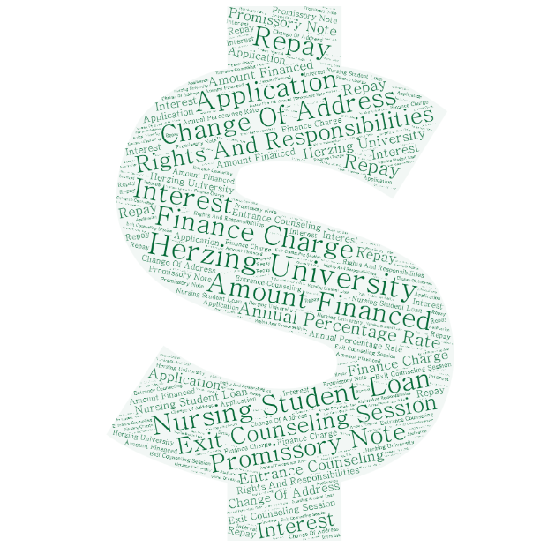
Rights and Responsibilities
Electronic exit counseling is required – University Accounting Services.
Notify Herzing if you change your address.
During your application process you were provided with financial disclosures. This information will be helpful as you enter repayment.
Your previously completed Master Promissory Note is your promise to repay this loan.
Reach out to Herzing if you have any questions!

Slide 5
Grace Periods
Loan Repayment Grace Period
Employment Grace Period
Starts on the first day of the month after you leave school or drop below half-time
Lasts for 9 months
Repayment of the principal loan balance is not required during this time
Interest begins to accrue on the first day of the fourth month of the grace period.
Allowed up to 12 months to gain employment following graduation
Goes beyond the grace period for repayment (9 months)
Allows borrowers additional time to meet their service obligation and receive loan cancellation

Slide 6
Grace Period – Tips!
Inform Herzing of any changes to your name or address
Know your loan amount including the interest rate
Contact Herzing before your payment due date if you are unable to pay for any reason - we can help you figure out your options
Options such as deferment, postponement, and/or cancellation are available
There is no penalty for paying early or more than is due
Enter the date and amount of your first payment into your phone calendar so you don’t miss it
Herzing has the right to withhold services such as official transcript printing, letters of recommendations, alumni materials, placement information, etc. if you are not communicating with us

Slide 7
Repayment Terms
10-year repayment period
Minimum $40/month
Monthly payments required
The interest accrues on the unpaid balance of the loan at 3% per year and begins 3 months after leaving school
If the course of study is not completed or you do not serve as a faculty member, the loan will bear interest on the unpaid balance of the loan at the prevailing market rate.

Slide 8

Penalties for Not Paying
A late charge when a payment is 60 days past due.
01
Default – which could result in the full balance becoming due.
02
Reports sent to credit bureaus that could affect credit scores.
03
Tax offsets to collect past due amounts.
04
Collection agencies calling.
05

Slide 9
Deferment and Forbearance
Deferment:
Interest does not accrue
Do not have to make payments
Approved reasons only – active duty orders, peace corps volunteering, continued Nursing education
You must apply through Herzing at least 30 days prior to the eligible activity beginning
Forbearance:
Interest will continue to accrue
Required to make interest-only payments
Approved reasons only
You must apply through Herzing
Time spent in the forbearance counts as part of the 10-year repayment period
This means your payments could increase when your forbearance ends to ensure you still repay the loan within the 10 years

Slide 10
NFLP Discharge
In the event of a borrower's death, the loan can be canceled in full
If the borrower becomes totally and permanently disabled, the borrower may be entitled to cancellation of any remaining payments due on the loan.
Permanent and total disability is defined as the borrower being unable to engage in gainful employment of any kind because of a medically determined impairment that this is expected to continue for a long and indefinite period of time or to result in death.
Requires submission of a certified death certificate.

Slide 11
Cancellation
To receive loan cancellation, the borrower must:
  be employed full-time as nurse faculty at an accredited school of nursing for a complete year, as is defined by the employing school of nursing or 12 consecutive months.
  submit the Request for Partial Cancellation of Loan form to Herzing University at the end of each complete year of full-time employment as faculty at a school of nursing.
Herzing will cancel an amount up to 85 percent of the loan (plus interest) as follows:
Upon completion by the Borrower of each of the first, second and third year of full-time employment as a faculty member in an accredited school of nursing, the school will cancel 20 percent of the principal of, and the interest on, the amount of the unpaid loan on the first day of employment.
Upon completion by the individual of the fourth year of full-time employment as a faculty member in an accredited school of nursing, the school will cancel 25 percent of the principal of, and the interest on, the amount of the unpaid loan on the first day of employment.

Slide 12

Notifications
University Accounting Services (UAS) is the servicer for your NFLP loan
UAS will email you notifications throughout your enrollment, grace period, and repayment.
Examples of notifications include
  Required exit counseling through UAS
  Required form for students who have graduated to prove employment and request loan cancellation

Slide 13
Herzing Support
Financial Aid Department
Call 866-508-0748 and select option 2
Email FA@herzing.edu
Alumni Support Financial Services Department
Call 866-508-0748 option 7
Email AlumniSupport@herzing.edu
Herzing University is available to assist all borrowers throughout enrollment and after graduation.

